Slide 1
Introduction to Statistical Methods
Dr Y V K Ravi Kumar, BITS- Pilani

Slide 2
Session 5: Random Variables _ Continuous
II Semester 2019 -20(Aug 2020)

Slide 3


Slide 5







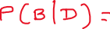

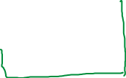
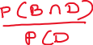


Slide 6




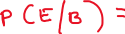



Slide 7
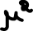


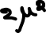


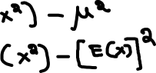

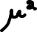




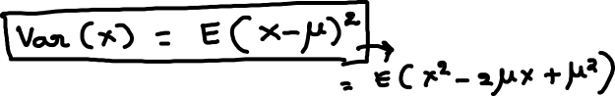


Slide 8
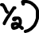


Slide 9
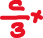





Slide 10



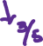







Slide 11
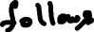


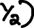
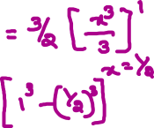

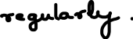


Slide 15
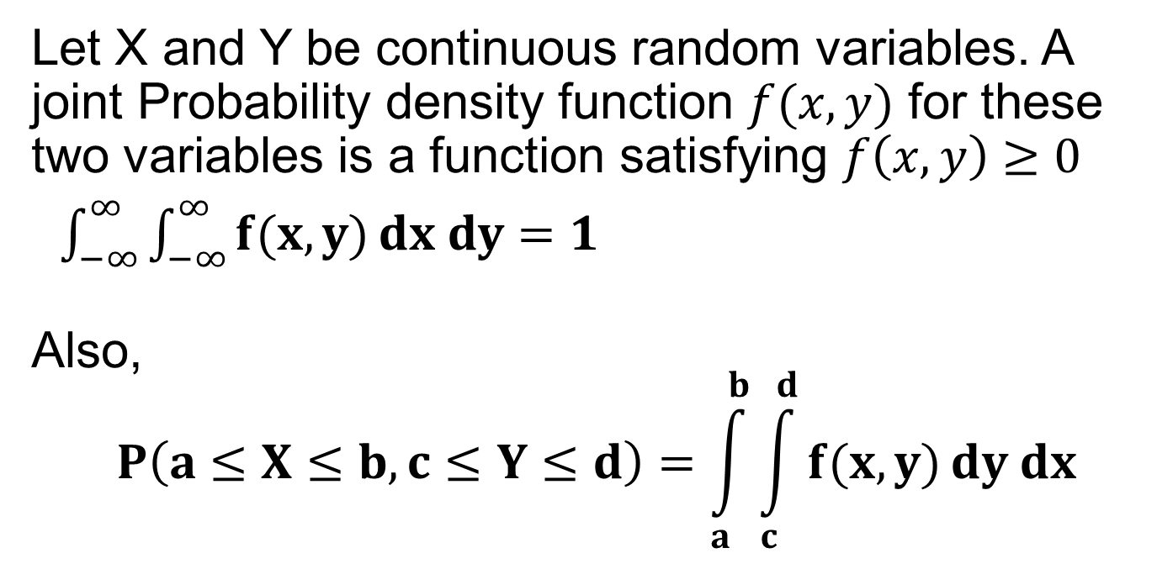
Joint Continuous probability distribution
Let X and Y be continuous random variables. A joint Probability density function $f(x, y)$ for these two variables is a function satisfying $f\left(x, y\right)≥0$
$\int_{−∞}^{∞}{\int_{−∞}^{∞}{f(x, y)}dx dy=1}$
Also,
$$P\left(a≤X≤b, c≤Y≤d\right)=\int_{a}^{b}{\int_{c}^{d}{f(x, y)}dy dx}$$

Slide 16
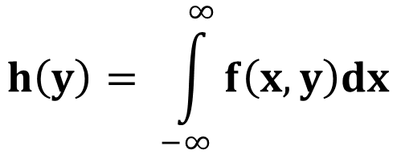
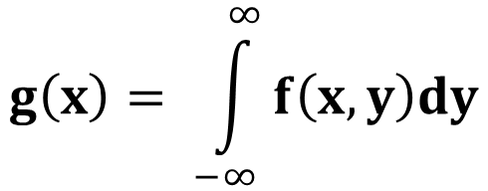
Let f(x, y) be the joint density function of the continuous random variables X and Y, then the marginal densities of X and Y will be obtained by integrating over the range of Y for X and over the range of X for Y, i.e.,
$$g\left(x\right)= \int_{−∞}^{∞}{f\left(x, y\right)dy}$$
$$h\left(y\right)= \int_{−∞}^{∞}{f\left(x, y\right)dx}$$

Slide 17
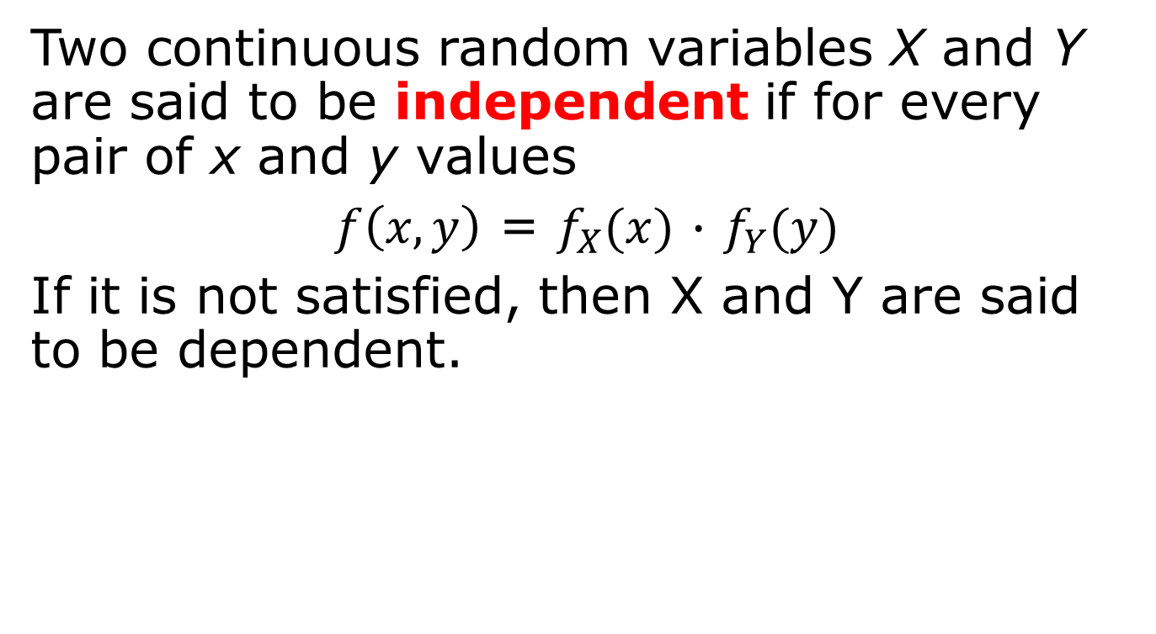
Two continuous random variables X and Y are said to be independent if for every pair of x and y values
$f\left(x, y\right)$ = $f_{X}(x)$ $∙$ $f_{Y}(y)$
If it is not satisfied, then X and Y are said to be dependent.

Slide 18
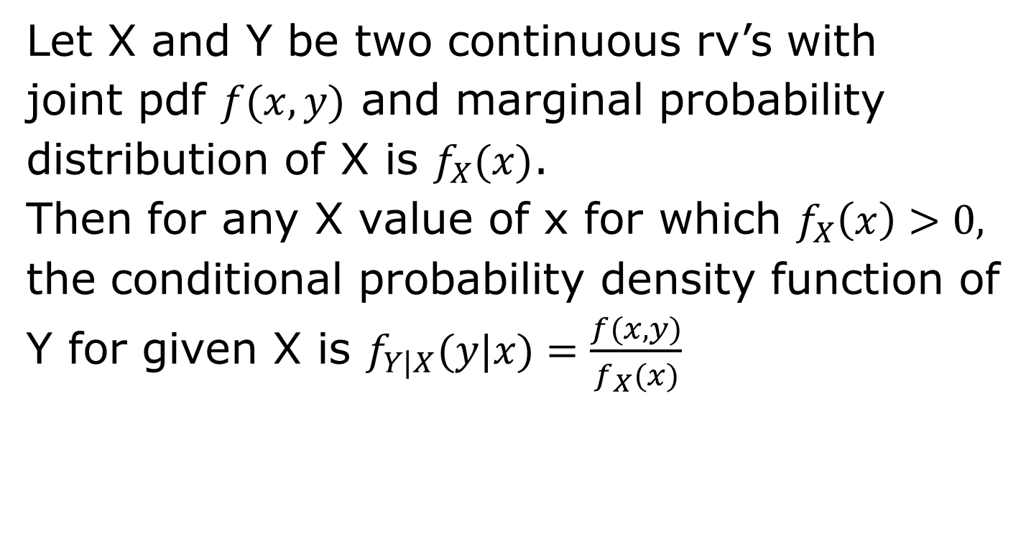
Let X and Y be two continuous rv’s with
joint pdf $f(x, y)$ and marginal probability
distribution of X is $f_{X}(x)$.
Then for any X value of x for which $f_{X}\left(x\right)>0,$
the conditional probability density function of
Y for given X is $f_{Y|X}(y|x)=\frac{f(x, y)}{f_{X}(x)}$

Slide 19
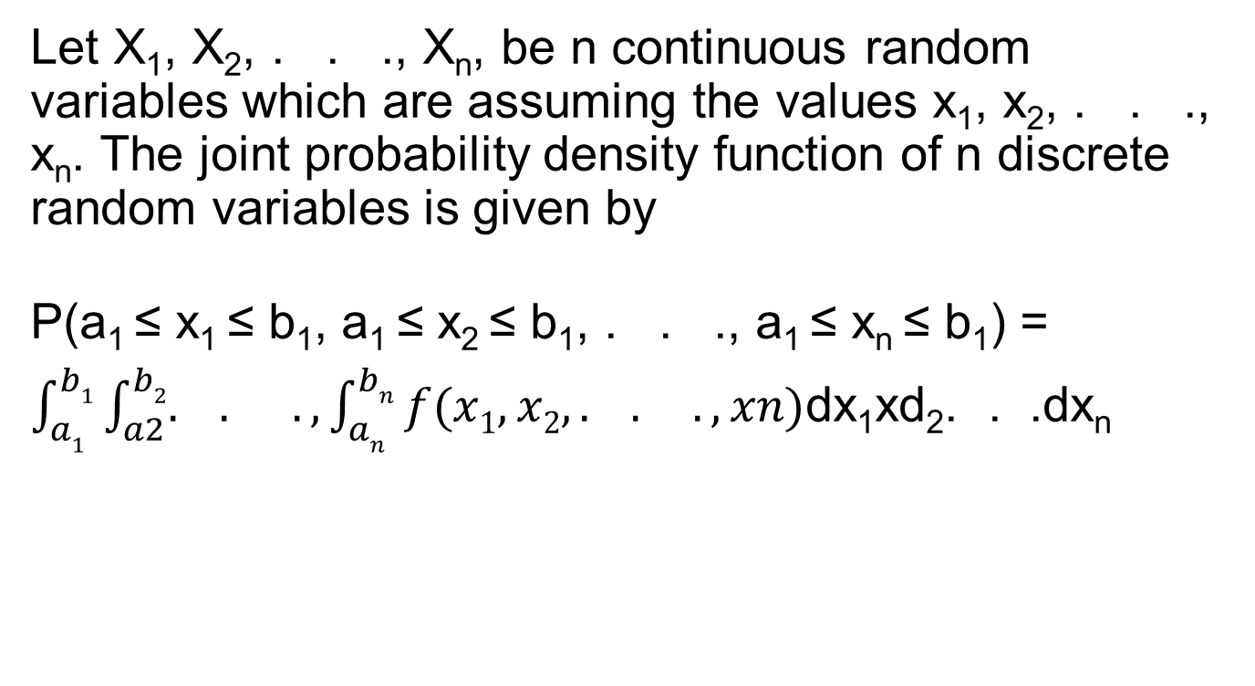
Let X₁, X₂, . . ., X_{n}, be n continuous random variables which are assuming the values x₁, x₂, . . ., x_{n}. The joint probability density function of n discrete random variables is given by
P(a₁ ≤ x₁ ≤ b₁, a₁ ≤ x₂ ≤ b₁, . . ., a₁ ≤ x_{n} ≤ b₁) =
$\int_{a1}^{b1}{\int_{a2}^{b2}{. . .,\int_{an}^{bn}{f(x1,x2, . . .,xn)}}}$dx₁xd₂. . .dx_{n}

Slide 20
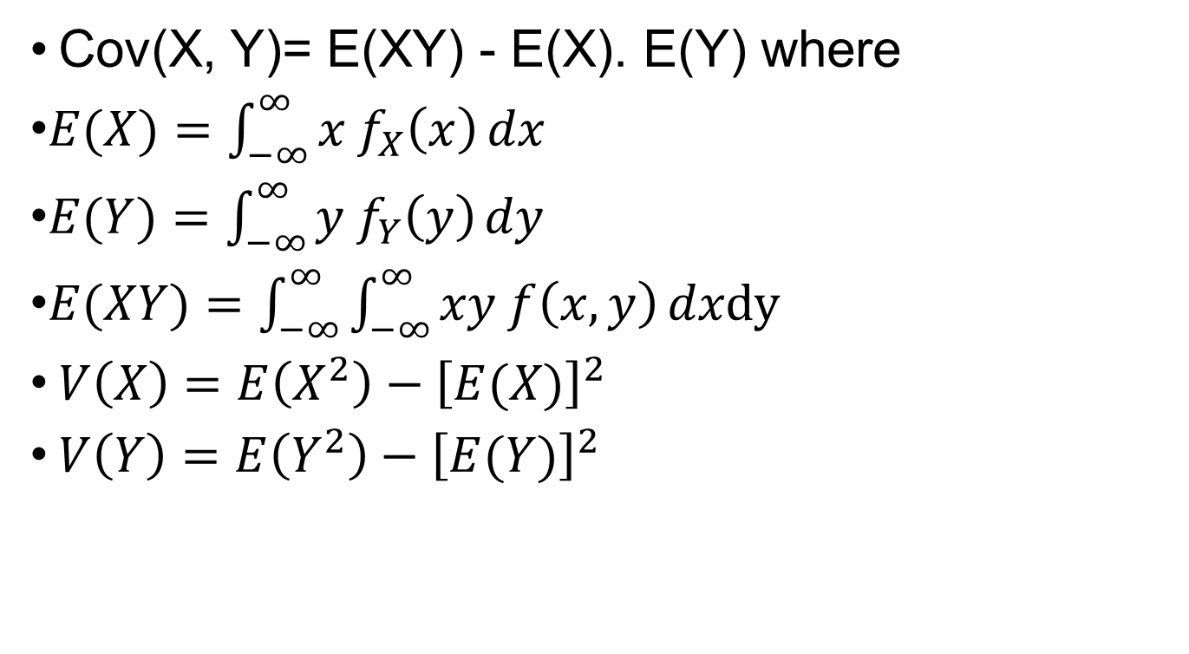
Cov(X, Y)= E(XY) - E(X). E(Y) where
$E(X)=\int_{−∞}^{∞}{x f_{X}\left(x\right)}dx$
$E(Y)=\int_{−∞}^{∞}{y f_{Y}\left(y\right)}dy$
$E(XY)=\int_{−∞}^{∞}{\int_{−∞}^{∞}{xy f\left(x, y\right)}}dxdy$
$V\left(X\right)=E\left(X^{2}\right)−{\left[E(X)\right]}^{2}$
$V\left(Y\right)=E\left(Y^{2}\right)−{\left[E(Y)\right]}^{2}$

Slide 21
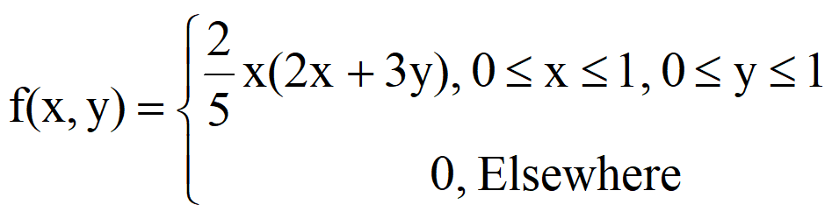
Probability Distribution
Joint Continuous probability distribution
Example 1: If
(i) Find P[X≤2/3, Y≤1/4]?

Slide 22
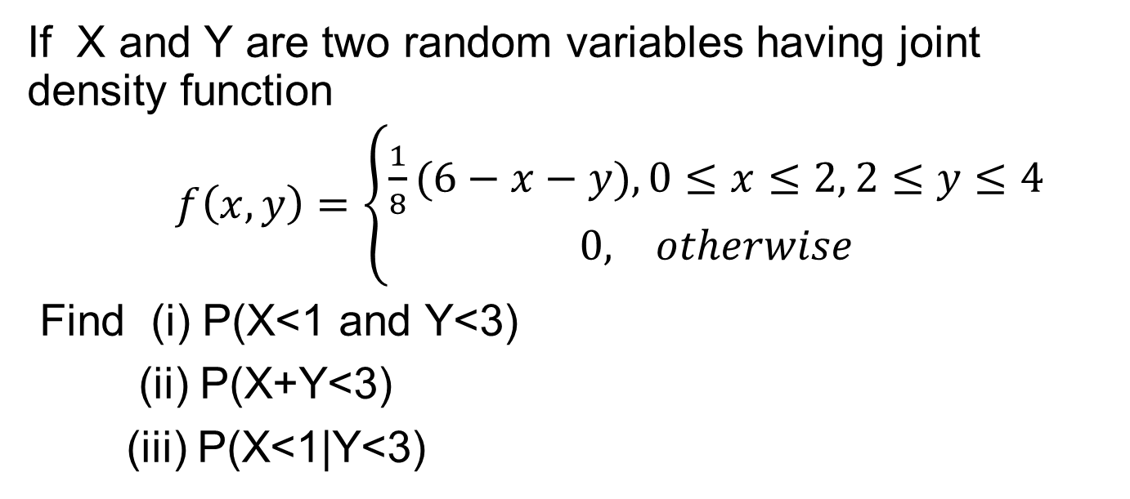
Probability Distribution
Joint probability distribution
Exercise 7
If X and Y are two random variables having joint density function
$f\left(x, y\right)=\left\{\begin{aligned}\frac{1}{8}(6−x−y),0≤x≤2, 2≤y≤4 \\ 0, otherwise\end{aligned}\right.$
Find (i) P(X<1 and Y<3)
(ii) P(X+Y<3)
(iii) P(X<1|Y<3)

Slide 23
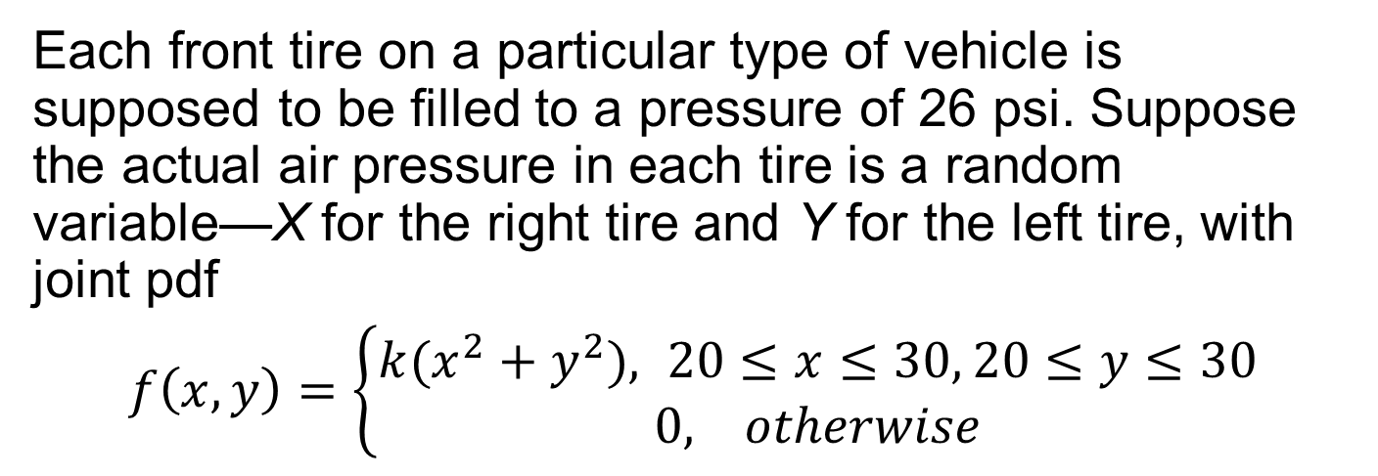
Probability Distribution
Joint probability distribution
Exercise 8
Each front tire on a particular type of vehicle is supposed to be filled to a pressure of 26 psi. Suppose the actual air pressure in each tire is a random variable—X for the right tire and Y for the left tire, with joint pdf
$f\left(x, y\right)=\left\{\begin{aligned}k{(x^{2}+y}^{2}), 20≤x≤30, 20≤y≤30 \\ 0, otherwise\end{aligned}\right.$

Slide 24
Probability Distribution
Joint probability distribution
What is the value of K?
What is the probability that both tires are under filled?
What is the probability that the difference in air pressure between the two tires is at most 2 psi?
Determine the (marginal) distribution of air pressure in the right tire alone.
Are X and Y independent rv’s?

Slide 25
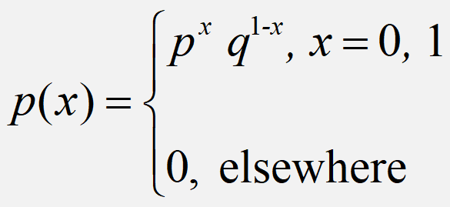
A random variable ‘X’ is said to have
Bernouli distribution if its probability mass
function is given by
Special Probability Distribution
Bernouli Distribution
Definition

Slide 26
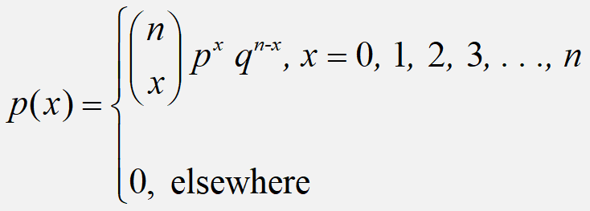
A random variable ‘X’ is said to have
Binomial distribution if its probability mass
function is given by
Statistical Methods for Data Science
Special Probability Distribution
Binomial Distribution
Definition

Slide 27
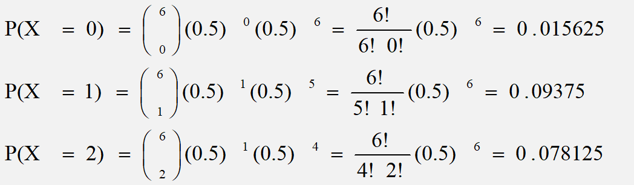
Special Probability Distribution
Binomial Distribution
If a coin is tossed 6 times, what is the probability of getting 2 or fewer heads?
P(x ≤ 2) = ∑p(x) = 0.015625 + 0.09375 + 0.078125 = 0.1875

Slide 28
Special Probability Distribution
Binomial Distribution
Nationalized bank sanctions short term loan for its customers. The probability of sanctioning loan by the bank is 0.53. If 5 persons are selected at random what is the probability that
(a) none were sanctioned loan?
(b) between 1 to 4 were sanctioned the
loan?
(c) more than 3 were sanctioned the loan?

Slide 29
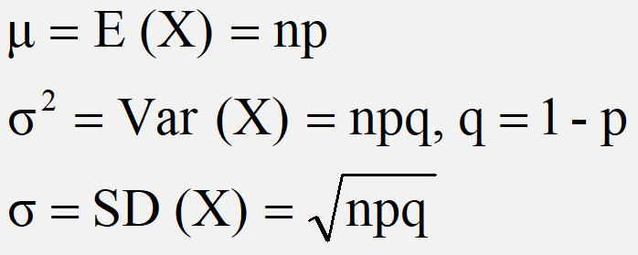
Special Probability Distribution
Binomial Distribution
All probability distributions are characterized by an
expected value and a variance
If X follows a binomial distribution with parameters n and p then we write X ~ B(n, p)
Note: the variance will always lie between
0*n - 0.25 *n
p(1 - p) reaches maximum at p=0.5
p(1 - p)=.025

Slide 30
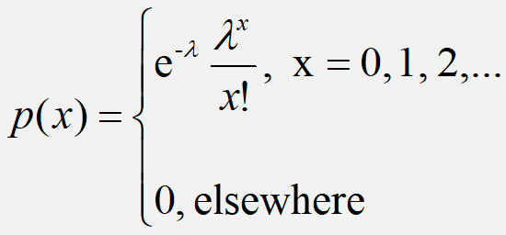
A random variable ‘X’ is said to have
Poisson distribution if its probability mass
function is given by
Special Probability Distribution
Poisson Distribution
Definition

Slide 31
Special Probability Distribution
Poisson Distribution
Police records show that number of accident victims died in road traffic accidents is 0.1%. What is the probability that among 500 randomly selected accident victims
(i) none have died?
(ii) at least 3 have died
(iii) between 2 and 6 have died

Slide 32
Let X and Y be two continuous rv’s with
joint pdf $f(x, y)$ and marginal probability
distribution of X is $f_{X}(x)$.
Then for any X value of x for which $f_{X}\left(x\right)>0,$
the conditional probability density function of
Y for given X is $f_{Y|X}(y|x)=\frac{f(x, y)}{f_{X}(x)}$

